Slide 1
Things Tried:
Other Boards – flex doesn’t work, board 2 is identical to board 1
Check whether testing on different batch changes accuracy - barely
Sigmoid output – model gets stuck trying to go beyond 20
Subtractive normalization – variation is correlated with distance to 0, divisive is better
Local normalization – only shows most extreme changes, need restructuring to work
At testing normalization – Drastically improves but no where near good…
Implement 0N force as random or 10/10 – improves model drastically
Screw…. Works best…. But shows hypersensitivity

Slide 2
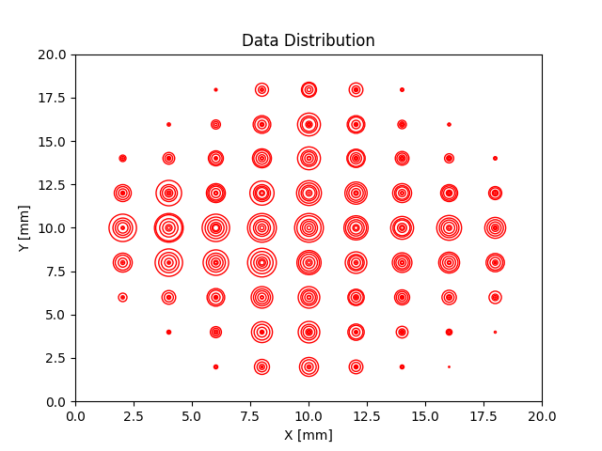
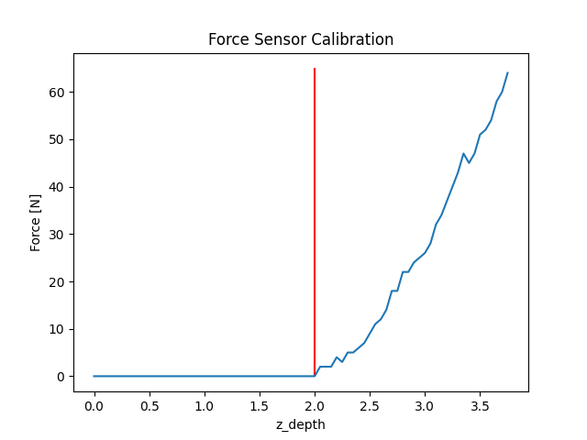
Setup

Slide 3
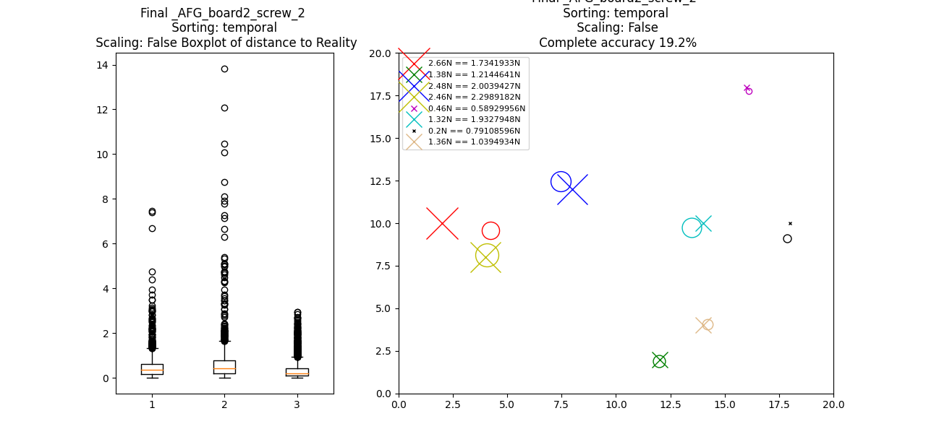
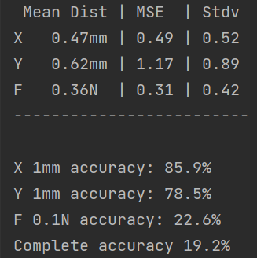
Best Model: 22000 Samples and 67 Epochs

Slide 4
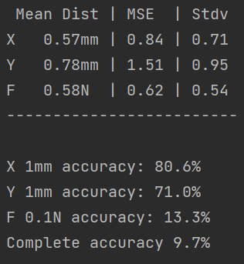
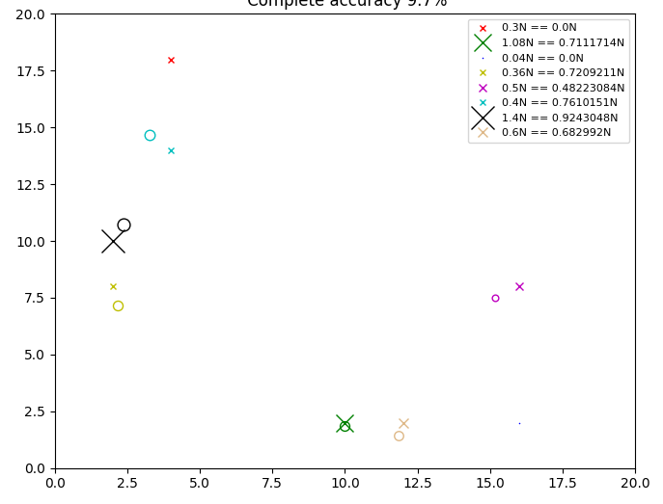
Temporal testing (22000 Screw) Random Separate Batch

Slide 5
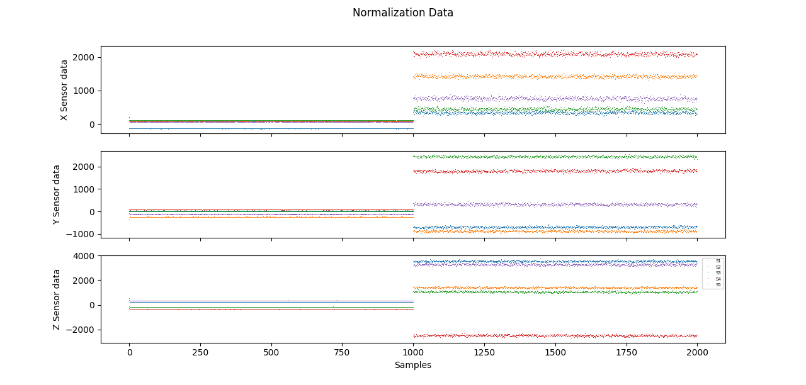
Normalization changes During Training 15 min later on desk

Slide 6
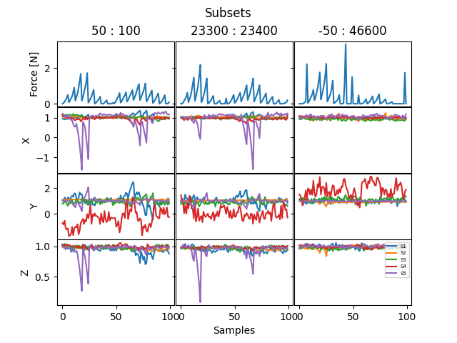
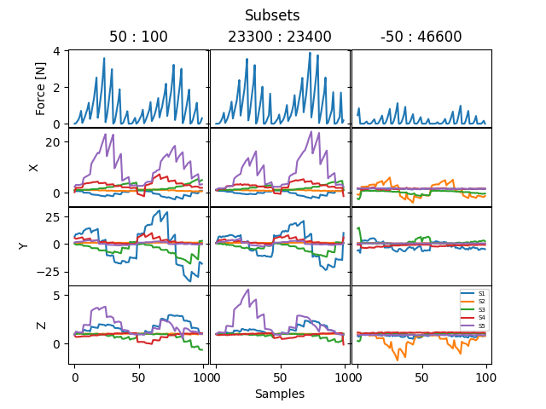
Data Board 2 Normal Screw

Slide 7
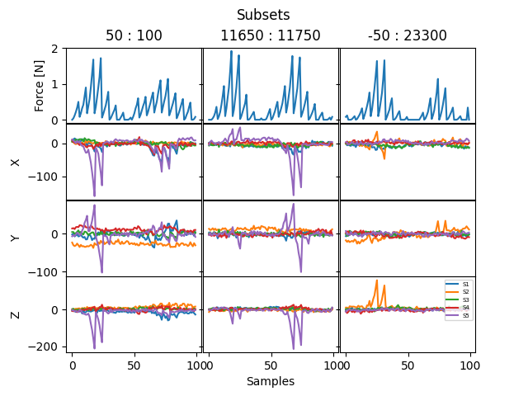
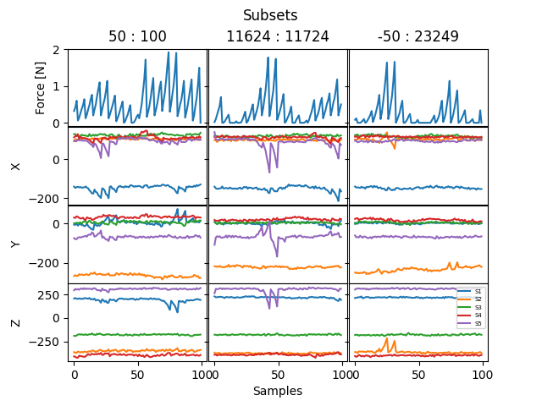
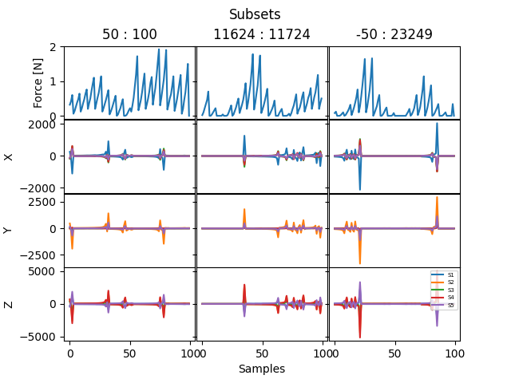
Data Board 2 Norm
Total Local
Subtractive
Divisive

Slide 8
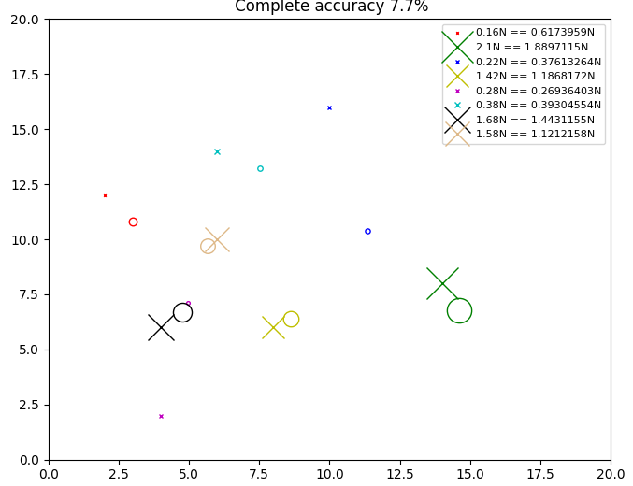
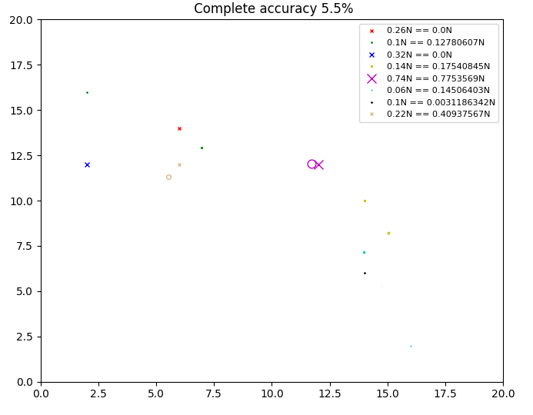
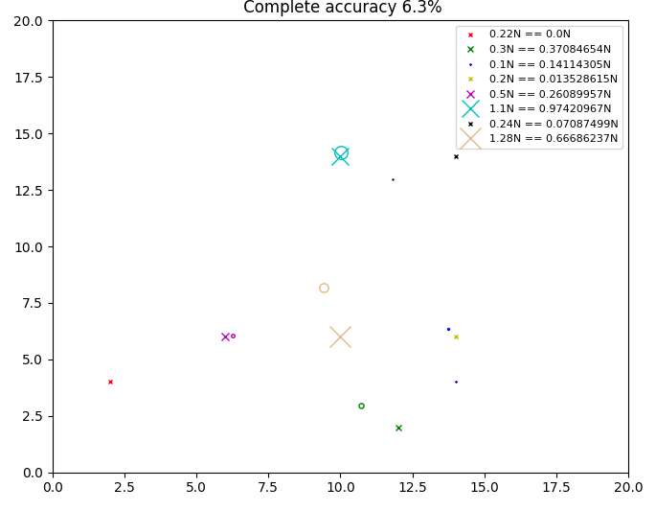
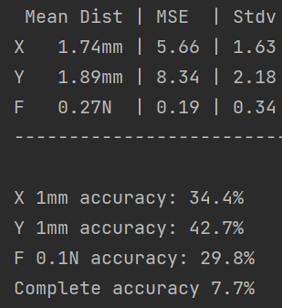
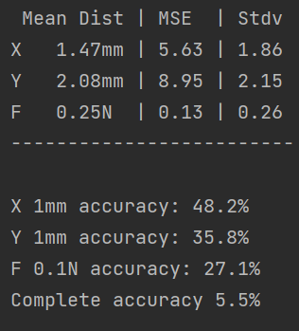
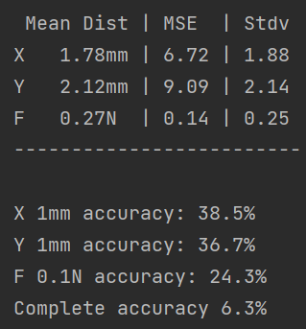
Board 2 Data
44000, 21 Epoch (2 sets = 100 iterations) | 22000 (1 set) 35 Epochs | 11000 35 Epoch(0.5 Set)

Slide 9
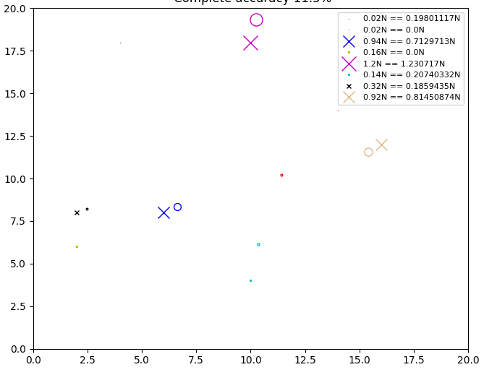
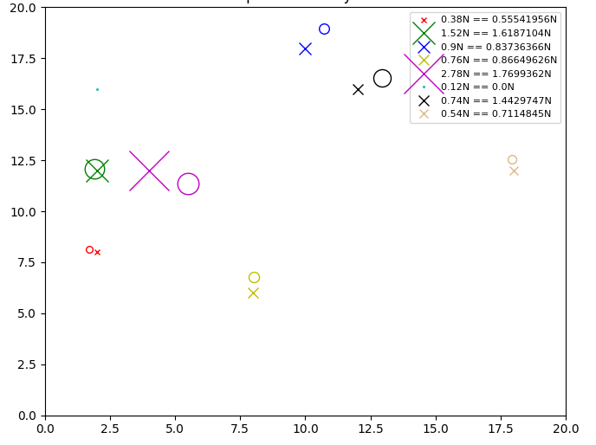
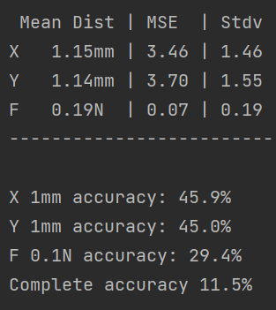
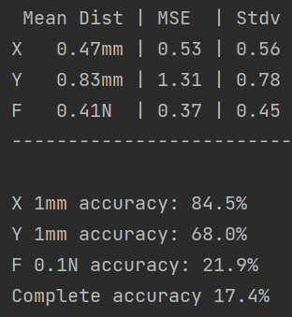
Screw Data
44000, 21 Epoch (2 sets = 100 iterations) | 22000 (1 set) 67 Epochs | 11000 67 Epochs (0.5 Set)

